Slide 1
CSE331
Automata and Computability
Turing Machines: decidable and recognizable languages
Lecture 15
Spring 2026

Slide 2
Today's learning goals Sipser Ch 3.1
Design TMs using different levels of descriptions
Give high-level description for TMs used in constructions
Prove properties of the classes of recognizable and decidable sets.

Slide 3
An example
L = { w#w | w is in {0,1}* }
Idea for Turing machine
Zig-zag across tape to corresponding positions on either side of '#' to check whether these positions agree. If they do not, or if there is no '#', reject. If they do, cross them off.
Once all symbols to the left of the '#' are crossed off, check for any symbols to the right of '#': if there are any, reject; if there aren't, accept.
How would you use this machine to prove that L is decidable?

Slide 4
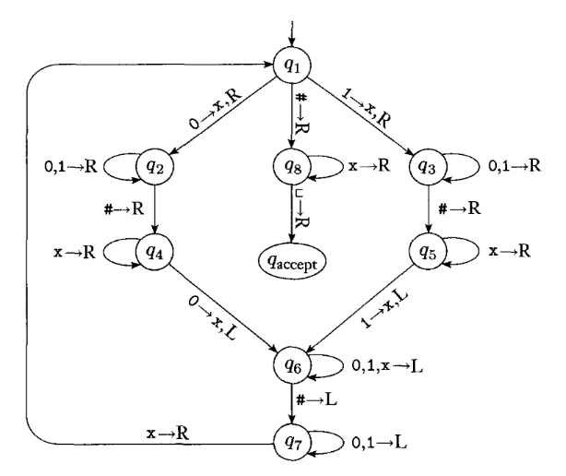
Q={q1,q2,q3,q4,q5,q6,q7,q8,q_{accept},q_{reject}}
Σ = {0,1,#}
Γ = {0,1,#,x,_ }
All missing transitions have output (q_{reject}, _, R)
Fig 3.10 in Sipser

Slide 5
Computation on input 0#0?
Configuration u q v
for current tape uv (and then all blanks), current head location is first symbol of v, current state q

Slide 6
Computation on input 0# ?
Configuration u q v
for current tape uv (and then all blanks), current head location is first symbol of v, current state q

Slide 7
Describing TMs Sipser p. 159
Formal definition: set of states, input alphabet, tape alphabet, transition function, state state, accept state, reject state.
Implementation-level definition: English prose to describe Turing machine head movements relative to contents of tape.
High-level desciption: Description of algorithm, without implementation details of machine. As part of this description, can "call" and run another TM as a subroutine.

Slide 8
An example
Which of the following is an implementation-level description of a TM which decides the empty set?
M = "On input w:
reject."
sweep right across the tape until find a non-blank symbol. Then, reject."
If the first tape symbol is blank, accept. Otherwise, reject."
More than one of the above.
I don't know.

Slide 9
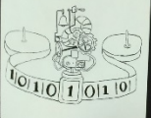
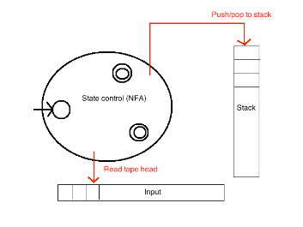

Turing recognizable languages
Turing decidable languages
Context-free languages
Regular languages

Slide 10
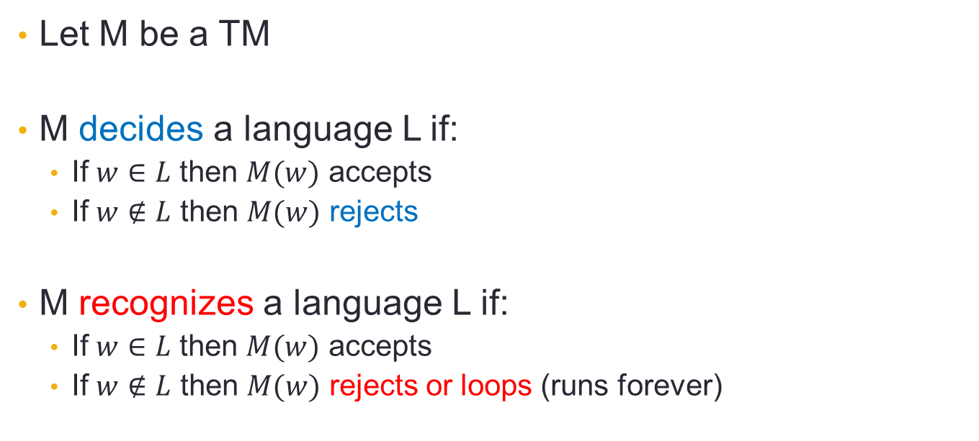
Decidable vs Recognizable
Let M be a TM
M decides a language L if:
  If $w∈L$ then $M(w)$ accepts
  If $w∉L$ then $M(w)$ rejects
M recognizes a language L if:
  If $w∈L$ then $M(w)$ accepts
  If $w∉L$ then $M(w)$ rejects or loops (runs forever)
M always halts!

Slide 11
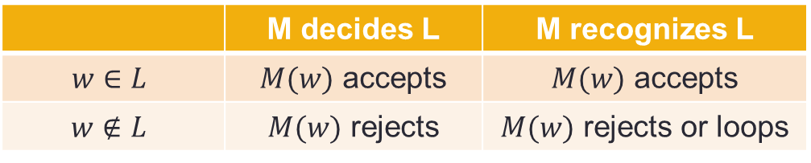
Decidable vs Recognizable
 | M decides L | M recognizes L
$$w∈L$$ | $M(w)$ accepts | $M(w)$ accepts
$$w∉L$$ | $M(w)$ rejects | $M(w)$ rejects or loops

Slide 12
Closure
Theorem: The class of decidable languages over fixed alphabet Σ is closed under union.
Proof: Let …
WTS …

Slide 13
Closure
Theorem: The class of decidable languages over fixed alphabet Σ is closed under union.
Proof: Let L₁ and L₂ be languages over Σ and suppose M₁ and M₂ are TMs deciding these languages. We will define a new TM, M, via a high-level description. We will then show that L(M) = L₁ U L₂ and that M always halts.

Slide 14
Closure
Theorem: The class of decidable languages over fixed
alphabet Σ is closed under union.
Proof: Let L₁ and L₂ be languages and suppose M₁ and M₂ are TMs deciding these languages.
Construct the TM M as "On input w,
Run M₁ on input w. If M₁ accepts w, accept. Otherwise, go to 2.
Run M₂ on input w. If M₂ accepts w, accept. Otherwise, reject."
Correctness of construction:
WTS L(M) = L₁ U L₂ and M is a decider.
Where do we use decidability?

Slide 15
Closure proof
M(w):
Run M1(w). If accepts, accept.
Run M2(w). If accepts, accept,
otherwise reject.
WTS L(M) = L₁ U L₂ and M is a decider.
If w in L₁:
  M1(w) accepts; so, M accepts w
If w in L₂:
  If M1(w) accepts, M accepts w
  If not, it rejects, and then M2(w) accepts.
  Either way, M accepts w.
If w not in L₁ U L₂:
  M1(w) rejects
  M2(w) rejects
  So, M rejects w.

Slide 16
Closure proof
M(w):
Run M1(w). If accepts, accept.
Run M2(w). If accepts, accept,
otherwise reject.
WTS L(M) = L₁ U L₂ and M is a decider.
If w in L₁:
  M1(w) accepts; so, M accepts w
If w in L₂:
  If M1(w) accepts, M accepts w
  If not, it rejects, and then M2(w) accepts.
  Either way, M accepts w.
If w not in L₁ U L₂:
  M1(w) rejects
  M2(w) rejects
  So, M rejects w.
M is a decider because
it accepts or rejects all inputs

Slide 17
Closure proof
M(w):
Run M1(w). If accepts, accept.
Run M2(w). If accepts, accept,
otherwise reject.
WTS L(M) = L₁ U L₂ and M is a decider.
If w in L₁:
  M1(w) accepts; so, M accepts w
If w in L₂:
  If M1(w) accepts, M accepts w
  If not, it rejects, and then M2(w) accepts.
  Either way, M accepts w.
If w not in L₁ U L₂:
  M1(w) rejects
  M2(w) rejects
  So, M rejects w.
Where do we use decidability of M1, M2?

Slide 18
Closure proof
M(w):
Run M1(w). If accepts, accept.
Run M2(w). If accepts, accept,
otherwise reject.
WTS L(M) = L₁ U L₂ and M is a decider.
If w in L₁:
  M1(w) accepts; so, M accepts w
If w in L₂:
  If M1(w) accepts, M accepts w
  If not, it rejects, and then M2(w) accepts.
  Either way, M accepts w.
If w not in L₁ U L₂:
  M1(w) rejects
  M2(w) rejects
  So, M rejects w.
Where do we use decidability of M1, M2?

Slide 19
Closure for recognizable languages?
Theorem: The class of recognizable languages over fixed
alphabet Σ is closed under union.
Can we adapt the proof from decidable languages?

Slide 20
Closure for recognizable languages?
Theorem: The class of recognizable languages over fixed
alphabet Σ is closed under union.
Proof attempt: Let L₁ and L₂ be languages and suppose M₁ and M₂ are TMs recognizing these languages.
Construct the TM M as "On input w,
Run M₁ on input w. If M₁ accepts w, accept. Otherwise, go to 2.
Run M₂ on input w. If M₂ accepts w, accept. Otherwise, reject.“
This proof has a bug! Can you find it?

Slide 21
Closure for recognizable languages?
Where does this proof fail?
M always halts
M never halts
M accepts some words outside L
M rejects some words in L
None of these
Theorem: The class of recognizable languages over fixed
alphabet Σ is closed under union.
Proof attempt: Let L₁ and L₂ be languages and suppose M₁ and M₂ are TMs recognizing these languages.
Construct the TM M as "On input w,
Run M₁ on input w. If M₁ accepts w, accept. Otherwise, go to 2.
Run M₂ on input w. If M₂ accepts w, accept. Otherwise, reject.“
This proof has a bug!

Slide 22
Closure for recognizable languages?
Theorem: The class of recognizable languages over fixed
alphabet Σ is closed under union.
Proof attempt: Let L₁ and L₂ be languages and suppose M₁ and M₂ are TMs recognizing these languages.
Construct the TM M as "On input w,
Run M₁ on input w. If M₁ accepts w, accept. Otherwise, go to 2.
Run M₂ on input w. If M₂ accepts w, accept. Otherwise, reject.“
ERROR: If M₁(w) runs forever, we never get to run M₂(w); we might not accept some words in L₂ !

Slide 23
Closure for recognizable languages?
Theorem: The class of recognizable languages over fixed
alphabet Σ is closed under union.
We need a different proof strategy!
Challenge: how would you solve this?

Slide 24
Running TMs in parallel
Main idea: run both TMs in parallel
This is what your OS is doing when it is running several programs at the same time
We will model it via running TMs for a limited number of steps

Slide 25
Step-bounded TM
Let M be a TM, running on input w
Define a new “bounded” TM - M_{bdd}(w,t):
  Run M(w) for at most t steps
  If in these steps M accepted, accept; if it rejected, reject
  If after t steps M(w) didn’t halt, then halt and reject
Claim:
If M_{bdd}(w,t) accepts then M(w) accepts
If M(w) accepts then for large enough t, M_{bdd}(w,t) accepts

Slide 26
Closure for recognizable languages
Theorem: The class of recognizable languages over fixed
alphabet Σ is closed under union.
Proof: Let L₁ and L₂ be languages and suppose M₁ and M₂ are TMs recognizing these languages.
Construct the TM M as "On input w,
t=1
While True:
  Run M_{1,bdd}(w,t). If it accepted, accept.
  Run M_{2,bdd}(w,t). If it accepted, accept.
  t=t+1

Slide 27
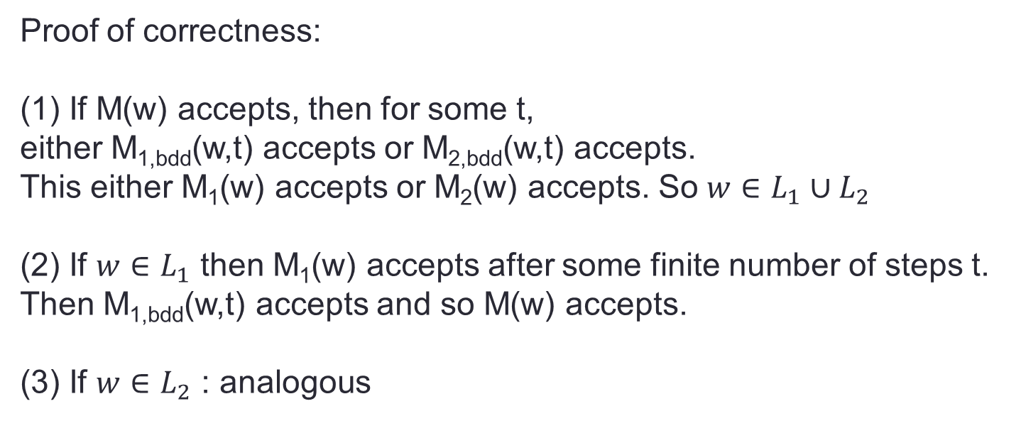
Closure for recognizable languages
M(w):
1. t=1
2. While True:
(a) Run M_{1,bdd}(w,t). If it accepted, accept.
(b) Run M_{2,bdd}(w,t). If it accepted, accept.
(c) t=t+1
Proof of correctness:
(1) If M(w) accepts, then for some t,
either M_{1,bdd}(w,t) accepts or M_{2,bdd}(w,t) accepts.
This either M₁(w) accepts or M₂(w) accepts. So $w∈L_{1}∪L_{2}$
(2) If $w∈L_{1}$ then M₁(w) accepts after some finite number of steps t.
Then M_{1,bdd}(w,t) accepts and so M(w) accepts.
(3) If $w∈L_{2}$ : analogous

Slide 28
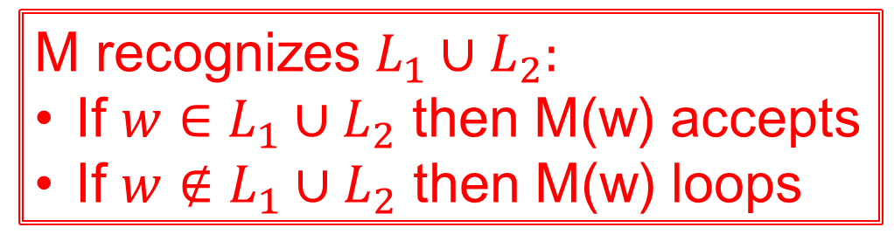
Closure for recognizable languages
M(w):
1. t=1
2. While True:
(a) Run M_{1,bdd}(w,t). If it accepted, accept.
(b) Run M_{2,bdd}(w,t). If it accepted, accept.
(c) t=t+1
Proof of correctness:
(1) If M(w) accepts, then for some t,
either M_{1,bdd}(w,t) accepts or M_{2,bdd}(w,t) accepts.
This either M₁(w) accepts or M₂(w) accepts. So $w∈L_{1}∪L_{2}$
(2) If $w∈L_{1}$ then M₁(w) accepts after some finite number of steps t.
Then M_{1,bdd}(w,t) accepts and so M(w) accepts.
(3) If $w∈L_{2}$ : analogous
M recognizes $L_{1}∪L_{2}:$
If $w∈L_{1}∪L_{2}$ then M(w) accepts
If $w∉L_{1}∪L_{2}$ then M(w) loops

Slide 29
Closure under complement
If L is decidable, is its complement decidable?
Yes
No
It depends on L
I don’t know

Slide 30
Closure under complement
If L is recognizable, is its complement recognizable?
Yes
No
It depends on L
I don’t know

Slide 31
Closure Good exercises – can't use without proof! (Sipser 3.15, 3.16)
The class of decidable languages is closed under
Union
Concatenation
Intersection
Kleene star
Complementation
The class of recognizable languages is closed under
Union
Concatenation
Intersection
Kleene star

Slide 32
Church-Turing thesis Sipser p. 183
Wikipedia "self-contained step-by-step set of operations to be performed"
"An algorithm is a finite sequence of precise instructions for performing a computation or for solving a problem."
Each algorithm can be implemented by some Turing machine.
Church-Turing thesis

